Slide 1
Computer Security
CS 526
Topic 5
Cryptography: Cryptographic Hash Functions And Message Authentication Code
CS526
Topic 5: Hash Functions and Message Authentication

Slide 2
Announcements
HW1 due on Sept 5
Quiz 1 will be on Sept 10, covering topics 1-5
Both projects will be allow a team of two
  May want to start forming teams
Mid-term exam tentatively scheduled to be Tuesday Oct 15, during lecture time
CS526
Topic 5: Hash Functions and Message Authentication

Slide 3

Readings for This Lecture
Wikipedia
  Cryptographic Hash Functions
  Message Authentication Code
CS526
Topic 5: Hash Functions and Message Authentication

Slide 4



Data Integrity and Source Authentication
Encryption does not protect data from modification by another party.
  Why?
Need a way to ensure that data arrives at destination in its original form as sent by the sender and it is coming from an authenticated source.
CS526
Topic 5: Hash Functions and Message Authentication
Notes:
Modified ciphertext can often still be decrypted into plaintexts?

Slide 5
Hash Functions
A hash function maps a message of an arbitrary length to a m-bit output
  output known as the fingerprint or the message digest
What is an example of hash functions?
  Give a hash function that maps Strings to integers in [0,2^{32}-1]
Cryptographic hash functions are hash functions with additional security requirements
CS526
Topic 5: Hash Functions and Message Authentication
Notes:
Example hash function: v:=1; for each character c, v=v*(c+1)+2 mod 2^{32};

Slide 6
Using Hash Functions for Message Integrity
Method 1: Uses a Hash Function h, assuming an authentic (adversary cannot modify) channel for short messages
  Transmit a message M over the normal (insecure) channel
  Transmit the message digest h(M) over the secure channel
  When receiver receives both M’ and h, how does the receiver check to make sure the message has not been modified?
This is insecure. How to attack it?
A hash function is a many-to-one function, so collisions can happen.
CS526
Topic 5: Hash Functions and Message Authentication
Notes:
An authenticated channel for short messages bootstraps authenticity.
A short secret key in encryption boostraps confidentiality.

Slide 7
Security Requirements for Cryptographic Hash Functions
Given a function h:X →Y, then we say that h is:
preimage resistant (one-way):
if given y ∈Y it is computationally infeasible to find a value x ∈X s.t. h(x) = y
2-nd preimage resistant (weak collision resistant):
if given x ∈ X it is computationally infeasible to find a value x’ ∈ X, s.t. x’≠x and h(x’) = h(x)
collision resistant (strong collision resistant):
if it is computationally infeasible to find two distinct values x’,x ∈ X, s.t. h(x’) = h(x)
CS526
Topic 5: Hash Functions and Message Authentication

Slide 8
Usages of Cryptographic Hash Functions
Software integrity
  E.g., tripwire
Timestamping
  How to prove that you have discovered a secret on an earlier date without disclosing it?
Covered later
  Message authentication
  One-time passwords
  Digital signature
CS526
Topic 5: Hash Functions and Message Authentication

Slide 9
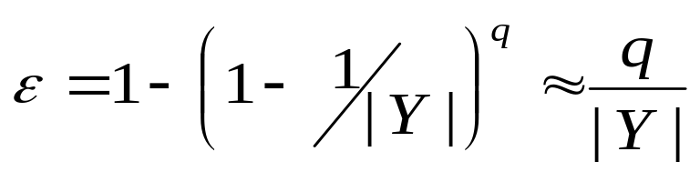
Bruteforce Attacks on Hash Functions
Attacking one-wayness
  Goal: given h:X→Y, y∈Y, find x such that h(x)=y
  Algorithm:
    pick a random value x in X, check if h(x)=y, if h(x)=y, returns x; otherwise iterate
    after failing q iterations, return fail
  The average-case success probability is
  Let |Y|=2^{m}, to get ε to be close to 0.5, q ≈2^{m-1}
CS526
Topic 5: Hash Functions and Message Authentication

Slide 10
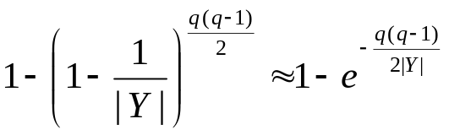
Bruteforce Attacks on Hash Functions
Attacking collision resistance
  Goal: given h, find x, x’ such that h(x)=h(x’)
  Algorithm: pick a random set X₀ of q values in X for each x∈X₀, computes y_{x}=h(x) if y_{x}=y_{x’} for some x’≠x then return (x,x’) else fail
  The average success probability is
  Let |Y|=2^{m}, to get ε to be close to 0.5, q ≈2^{m/2}
  This is known as the birthday attack.
CS526
Topic 5: Hash Functions and Message Authentication
Notes:
Assuming |Y|=N. With q choices, the Prob that there is no collision is
P = (N-1)/N * (N-2)/N * … * (N-q+1)/N = Π_{[i=1 to q-1]} (1 – i/N)
1-i/N ≈ e^{-i/N}
P ≈ e^{- Σ _{[i=1 to q-1]} i/N} = e^{-q(q-1) / 2N }

Slide 11
Well Known Hash Functions
MD5
  output 128 bits
  collision resistance completely broken by researchers in China in 2004
SHA1
  output 160 bits
  no collision found yet, but method exist to find collisions in less than 2^80
  considered insecure for collision resistance
  one-wayness still holds
SHA2 (SHA-224, SHA-256, SHA-384, SHA-512)
  outputs 224, 256, 384, and 512 bits, respectively
  No real security concerns yet
CS526
Topic 5: Hash Functions and Message Authentication

Slide 12
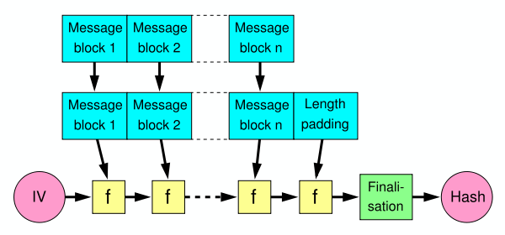
Merkle-Damgard Construction for Hash Functions
Message is divided into fixed-size blocks and padded
Uses a compression function f, which takes a chaining variable (of size of hash output) and a message block, and outputs the next chaining variable
Final chaining variable is the hash value
M=m₁m₂…m_{n}; C₀=IV, C_{i+1}=f(C_{i},m_{i}); H(M)=C_{n}
CS526
Topic 5: Hash Functions and Message Authentication

Slide 13
NIST SHA-3 Competition
NIST is having an ongoing competition for SHA-3, the next generation of standard hash algorithms
2007: Request for submissions of new hash functions
2008: Submissions deadline. Received 64 entries. Announced first-round selections of 51 candidates.
2009: After First SHA-3 candidate conference in Feb, announced 14 Second Round Candidates in July.
2010: After one year public review of the algorithms, hold second SHA-3 candidate conference in Aug. Announced 5 Third-round candidates in Dec.
2011: Public comment for final round
2012: October 2, NIST selected SHA3
  Keccak (pronounced “catch-ack”) created by Guido Bertoni, Joan Daemen and Gilles Van Assche, Michaël Peeters
CS526
Topic 5: Hash Functions and Message Authentication

Slide 14
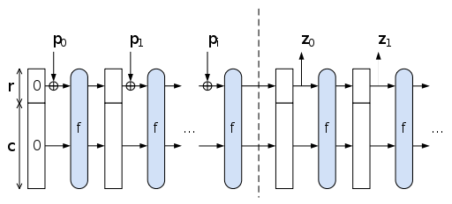
The Sponge Construction: Used by SHA-3
Each round, the next r bits of message is XOR’ed into the first r bits of the state, and a function f is applied to the state.
After message is consumed, output r bits of each round as the hash output; continue applying f to get new states
SHA-3 uses 1600 bits for state size
CS526
Topic 5: Hash Functions and Message Authentication

Slide 15
Choosing the length of Hash outputs
The Weakest Link Principle:
  A system is only as secure as its weakest link.
Hence all links in a system should have similar levels of security.
Because of the birthday attack, the length of hash outputs in general should double the key length of block ciphers
  SHA-224 matches the 112-bit strength of triple-DES (encryption 3 times using DES)
  SHA-256, SHA-384, SHA-512 match the new key lengths (128,192,256) in AES
CS526
Topic 5: Hash Functions and Message Authentication
Notes:
Which hash function to use?

Slide 16
Limitation of Using Hash Functions for Authentication
Require an authentic channel to transmit the hash of a message
  Without such a channel, it is insecure, because anyone can compute the hash value of any message, as the hash function is public
  Such a channel may not always exist
How to address this?
  use more than one hash functions
  use a key to select which one to use
CS526
Topic 5: Hash Functions and Message Authentication

Slide 17
Hash Family
A hash family is a four-tuple (X,Y,K,H ), where
  X is a set of possible messages
  Y is a finite set of possible message digests
  K is the keyspace
  For each K∈K, there is a hash function h_{K}∈H . Each h_{K}: X →Y
Alternatively, one can think of H as a function K×X→Y
CS526
Topic 5: Hash Functions and Message Authentication

Slide 18
Message Authentication Code
A MAC scheme is a hash family, used for message authentication
MAC(K,M) = H_{K}(M)
The sender and the receiver share secret K
The sender sends (M, H_{k}(M))
The receiver receives (X,Y) and verifies that H_{K}(X)=Y, if so, then accepts the message as from the sender
To be secure, an adversary shouldn’t be able to come up with (X’,Y’) such that H_{K}(X’)=Y’.
CS526
Topic 5: Hash Functions and Message Authentication

Slide 19
Security Requirements for MAC
Resist the Existential Forgery under Chosen Plaintext Attack
  Challenger chooses a random key K
  Adversary chooses a number of messages M₁, M₂, .., M_{n}, and obtains t_{j}=MAC(K,M_{j}) for 1≤j≤n
  Adversary outputs M’ and t’
  Adversary wins if ∀j M’≠M_{j}, and t’=MAC(K,M’)
Basically, adversary cannot create the MAC for a message for which it hasn’t seen an MAC
CS526
Topic 5: Hash Functions and Message Authentication
Notes:
Good homework problem, break simple MAC constructions.
MAC uses shared secret key to bootstrap integrity/authenticity.

Slide 20
Constructing MAC from Hash Functions
Let h be a one-way hash function
MAC(K,M) = h(K || M), where || denote concatenation
  Insecure as MAC
  Because of the Merkle-Damgard construction for hash functions, given M and t=h(K || M), adversary can compute M’=M||Pad(M)||X and t’, such that h(K||M’) = t’
CS526
Topic 5: Hash Functions and Message Authentication

Slide 21
HMAC: Constructing MAC from Cryptographic Hash Functions
  HMAC_{K}[M] = Hash[(K⁺ ⊕ opad) || Hash[(K⁺ ⊕ ipad)||M)]]
K⁺ is the key padded (with 0) to B bytes, the input block size of the hash function
ipad = the byte 0x36 repeated B times
opad = the byte 0x5C repeated B times.
At high level, HMAC_{K}[M] = H(K || H(K || M))
CS526
Topic 5: Hash Functions and Message Authentication

Slide 22
HMAC Security
If used with a secure hash functions (e.g., SHA-256) and according to the specification (key size, and use correct output), no known practical attacks against HMAC
CS526
Topic 5: Hash Functions and Message Authentication

Slide 23

Coming Attractions …
Cryptography: Public Key Cryptography
CS526
Topic 5: Hash Functions and Message Authentication

